Slide 1
COVID-19 Vaccination Program Multilingual communication toolkit
31 May 2021

Slide 2
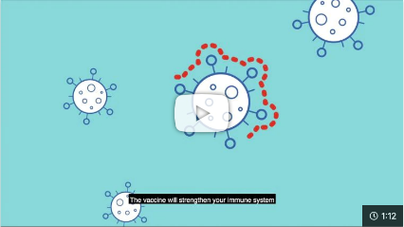
Purpose of this toolkit
The national COVID-19 Vaccination Program continues with tens of thousands of Australians every day receiving a COVID-19 vaccine. Vaccination is voluntary and free. Everyone is encouraged to get vaccinated when it’s their turn to help protect themselves, their family and the NSW community from COVID-19.​
We understand people in your community may look to you for information. This toolkit contains easy to read resources and links to translated information to help you:​
communicate about the COVID-19 Vaccination Program in NSW
answer questions and address misinformation
highlight the importance of continuing with COVID safe behaviours, even after vaccination.
In line with the Therapeutic Goods Administration regulations, content from the Australian and State Governments about COVID-19 vaccines may be shared but not changed or adapted. Please let us know if you need specific content for your community.
If you require further information or have any questions, visit nsw.gov.au or contact covid.communications@customerservice.nsw.gov.au.
Thank you once again for your support.
Link: COVID-19 vaccines – How vaccines work

Slide 3
Multilingual COVID-19 support
Translating and interpreting service (TIS National) If you need a free telephone interpreter, ring 131 450 and say the language you need. Ask the interpreter to connect you to the COVID-19 Vaccine Helpline. TIS is available 24 hours a day, 7 days a week or visit tisnational.gov.au.
National Coronavirus COVID-19 Vaccine Helpline 1800 020 080 is available 24 hours a day, 7 days a week.
The PICAC Multilingual Older Persons COVID-19 Support Line is available Monday to Friday 2pm – 5pm in the following languages:
1800 549 844 – Italian
1800 549 845 – Greek
1800 549 846 – Vietnamese
1800 549 847 – Mandarin
1800 549 848 – Cantonese
1800 549 849 – Arabic.
The NSW Health website has a translated resource page and digital resource library with translated materials.
Link: Multilingual Older Persons COVID-19 Support Line (translated posters available for download)

Slide 4
COVID-19 Vaccination Program content
Following pages include:
- Glossary of COVID-19 vaccine terminology
- COVID-19 vaccination program eligibility infographic
- 50+ booking information and resources
- 40-49 register your interest newsletter copy
- Vaccination program and COVID-19 vaccine factsheets
- Vaccination videos and content library
- COVID-19 vaccine presentation (for sharing with your community)
- Australian Government Stakeholder pack – May 2021
- Australian Government COVID-19 Vaccine Resource Hub
- SBS Coronavirus Portal

Slide 5
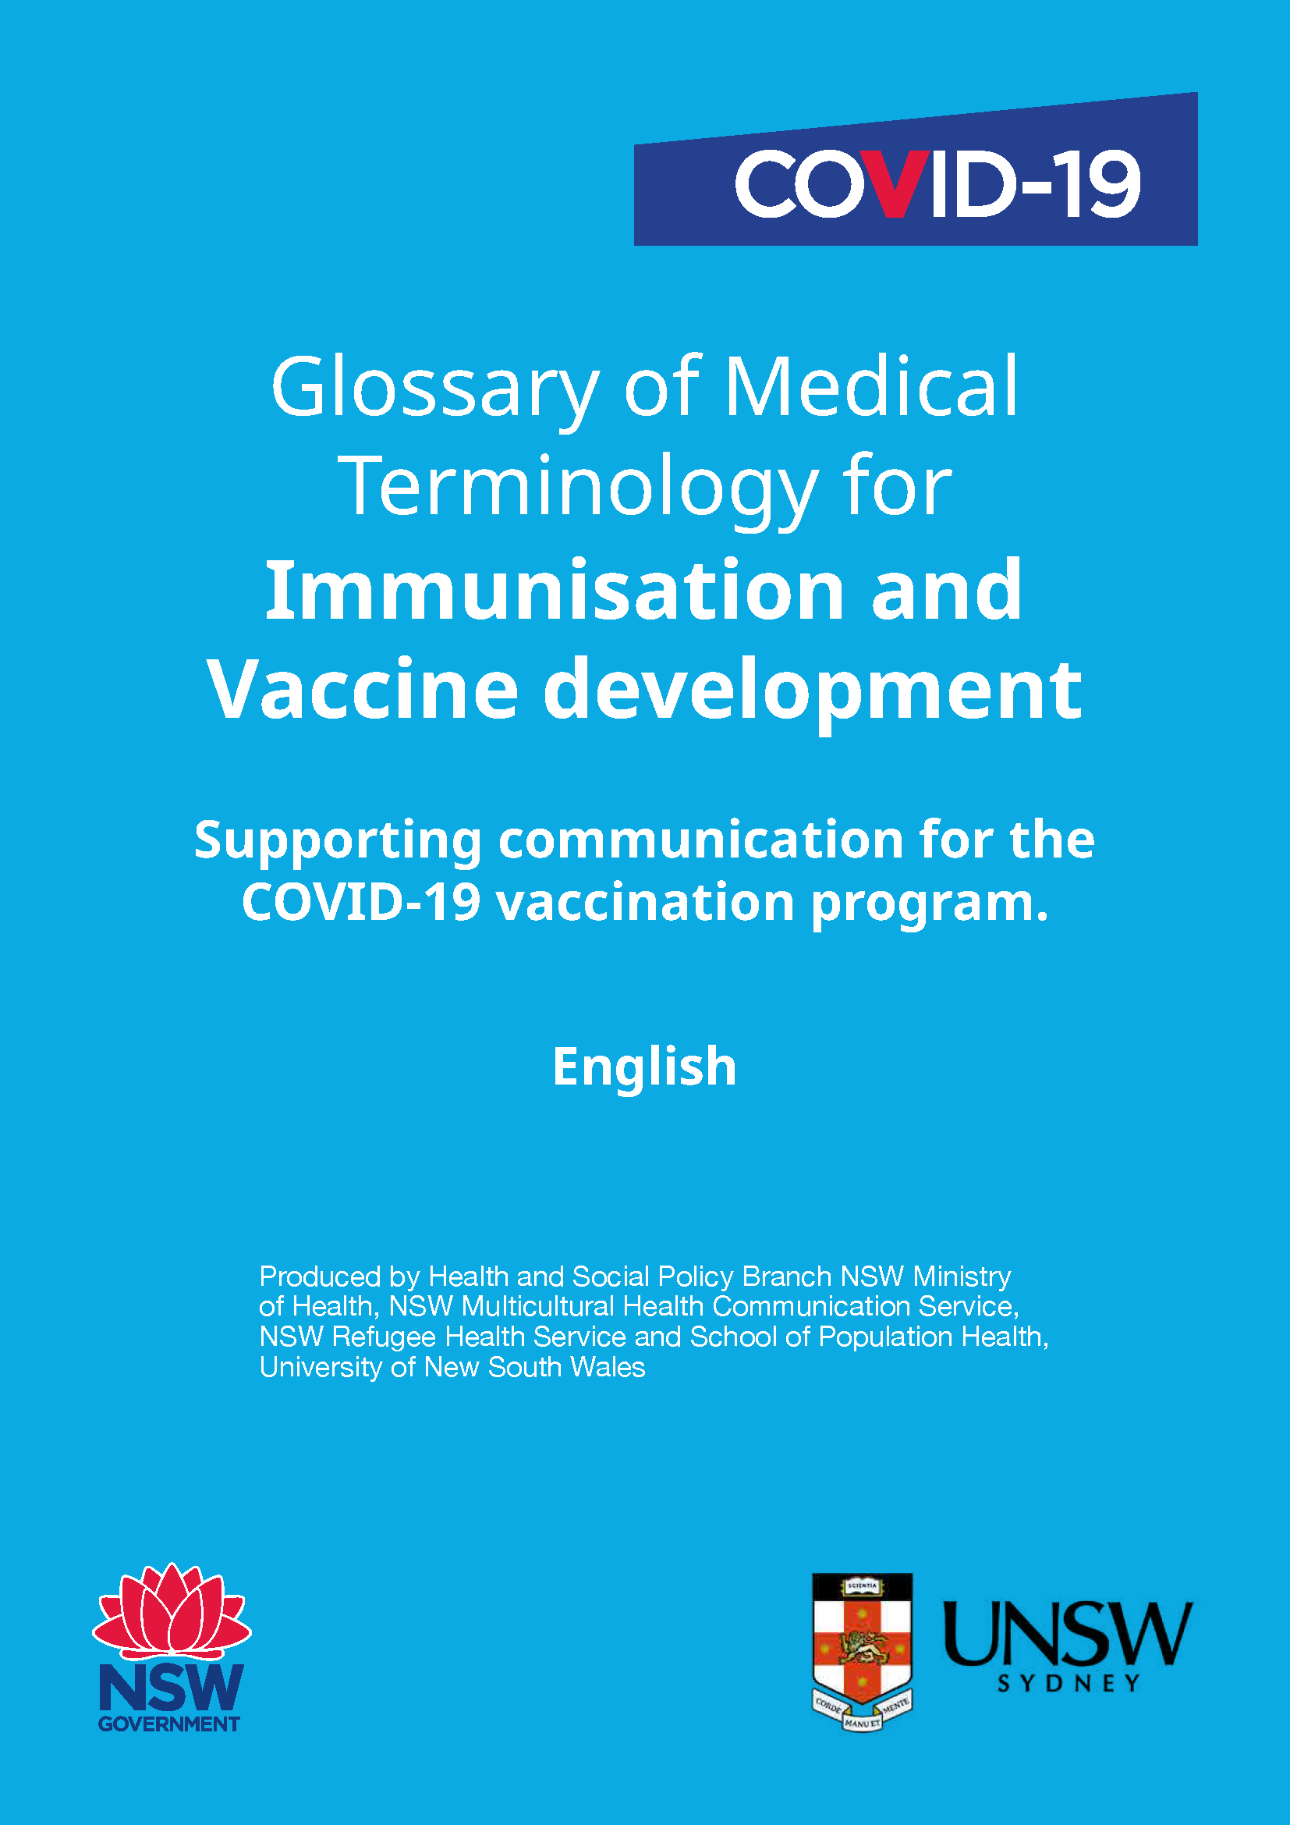
COVID-19 Vaccination Program: Glossary of COVID-19 vaccine terminology
Supporting communications for the COVID-19 Vaccination Program
This COVID-19 glossary was developed to help community organisations, translators and interpreters, bilingual workers, and community leaders to better understand and communicate about vaccine development and implementation.
Currently the glossary is available in English, Simplified Chinese and Italian.
In-language versions available shortly: Arabic, Assyrian/Aramaic, Bahasa Indonesia, Bengali, Burmese, Traditional Chinese, Dari, Dinka, Farsi, Greek, Hazaragi, Hindi, Korean, Kurdish Kurmanji, Kurdish Sorani, Macedonian, Mongolian, Nepali, Portuguese, Punjabi, Spanish, Swahili, Tagalog, Tamil, Thai, Tibetan, Urdu and Vietnamese.
Link: COVID-19 Glossary (English, Simplified Chinese and Italian)

Slide 6
COVID-19 Vaccination Program: easy to read COVID-19 Vaccination Program infographic
To download right click and select ‘Save as Picture’
About the COVID-19 Vaccination Program

Slide 7
COVID-19 Vaccination Program: easy to read 50+ now eligible for COVID-19 vaccine website/newsletter copy
Aged 50 or over? The COVID-19 Vaccination Program now includes you
If you’re aged 50 years or over, you’re eligible for a free COVID-19 vaccine regardless of your Medicare or visa status. The risk of severe complications from COVID-19 increases the older we are, and the vaccine is highly effective at reducing the risk of serious illness or death from the virus.
Where can I get my AstraZeneca COVID-19 vaccine?
There are more than 1,000 vaccination locations across NSW.
Our General Practitioner (GP) network is leading AstraZeneca COVID-19 vaccinations. If you are aged 50 or over, you can book your AstraZeneca vaccine appointment with your GP.
If you do not have a GP, or your GP is not offering COVID-19 vaccination, please use the COVID-19 Vaccine Eligibility Checker at covidvaccine.healthdirect.gov.au to find a clinic near you and make an appointment.
Participating GPs are best placed to answer any further questions you have about the COVID-19 vaccine.
NSW Health vaccination clinics are available across NSW including in rural and regional areas.
About the COVID-19 Vaccination Program
To download right click and select ‘Save as Picture’

Slide 8
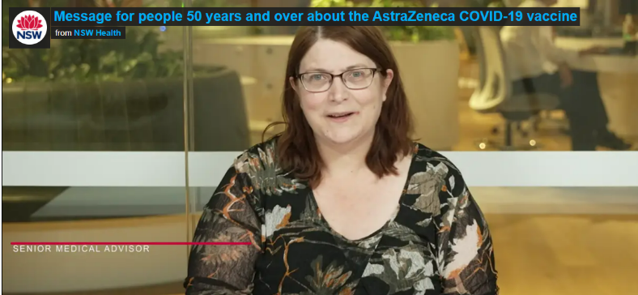
COVID-19 Vaccination Program: updated advice for people 50 years and over
Message from NSW Health’s Dr Jan Fizzell
People have questions about the recommendations for the AstraZeneca COVID-19 vaccine. NSW Health Senior Medical Advisor Dr Jan Fizzell explains why the Australian Technical Advisory Group for Immunisation (ATAGI) is recommending people 50 years and over should still get the AstraZeneca COVID-19 vaccine.
If you are under 50 and have already received your first dose of the AstraZeneca COVID-19 vaccine without serious side effects, you should feel confident to get the second dose.
For more information about the AstraZeneca COVID-19 vaccines, including translated resources, visit the Australian Government Department of Health website: www.health.gov.au/initiatives-and-programs/covid-19-vaccines/learn-about-covid-19-vaccines
Link to download: Message for people 50 years and over about the AstraZeneca COVID-19 vaccine

Slide 9
COVID-19 Vaccination Program: easy to read 50+ now eligible for COVID-19 vaccine resources
To download right click and select ‘Save Media as’
About the COVID-19 Vaccination Program
People aged 50+ are now eligible for the COVID-19 vaccine – social animation
Link: We've been vaccinated - poster

Slide 10
COVID-19 Vaccination Program: easy to read 40-49 register of interest newsletter copy
Aged 40-49? You can now register your interest for the Pfizer COVID-19 vaccine
If you are aged 40-49 years old, you can now register your interest for the Pfizer COVID-19 vaccination. It is free and voluntary.
Those who have registered their interest will be contacted when appointments to receive the vaccine become available in their area.
How do I register my interest for the Pfizer COVID-19 vaccine?
Visit nsw.gov.au
Select the register your interest button
Enter the required details
Submit the form
For more information on how to register your interest visit nsw.gov.au or call Service NSW on 13 77 88, 24 hours a day, 7 days a week.
For a free telephone interpreter ring TIS National on 131 450 (24-hour helpline), say the language you need. Ask the interpreter to connect you to Service NSW.
About the COVID-19 Vaccination Program
To download right click and select ‘Save as Picture’

Slide 11
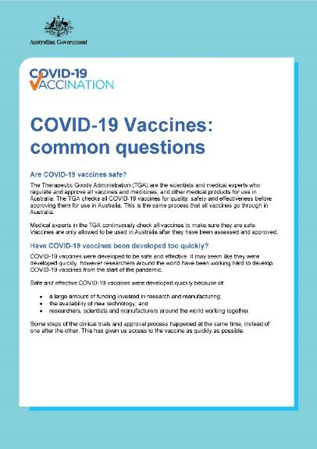
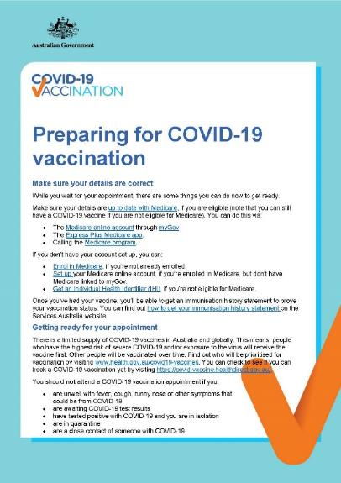
COVID-19 Vaccination Program: Australian Government COVID-19 vaccine factsheets
Available in: Albanian, Amharic, Arabic, Armenian, Assyrian, Bengali, Bosnian, Bulgarian, Burmese, Chin Hakha, Simplified Chinese, Traditional Chinese, Croatian, Dari, Dinka, Dutch, English, Finnish, French, German, Greek, Gujarati, Hazaragi, Hebrew, Hindi, Hmong, Indonesian, Italian, Japanese, Karen, Khmer, Kirundi, Korean, Kurdish, Laotian, Macedonian, Malayalam, Maltese, Nepali, Pashto, Persian, Polish, Portuguese, Punjabi, Rohingya, Romanian, Russian, Samoan, Serbian, Sinhala, Slovak, Slovenian, Somali, Spanish, Swahili, Tagalog, Tamil, Thai, Tibetan, Tigrinya, Turkish, Ukrainian, Urdu and Vietnamese.
Link to translations: COVID-19 vaccines: common questions
Link to translations: Preparing for COVID-19 vaccination

Slide 12
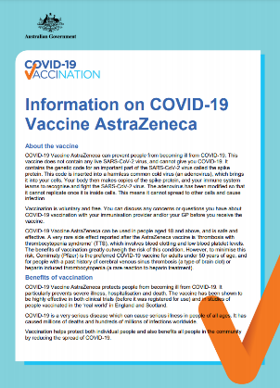
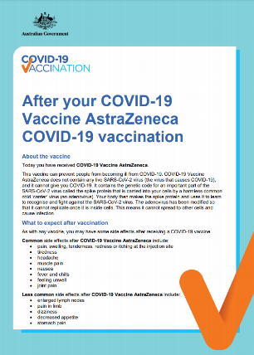
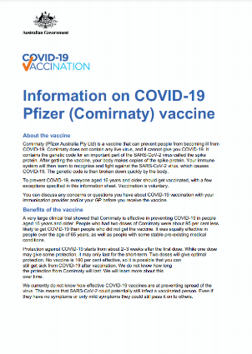
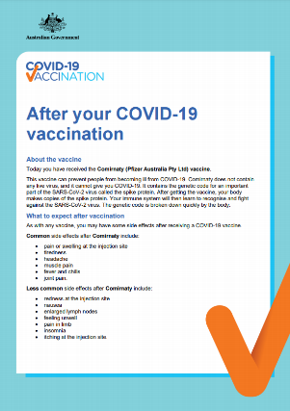
COVID-19 Vaccination Program: AstraZeneca and Pfizer COVID-19 vaccine factsheets
Available in: Albanian, Amharic, Arabic, Armenian, Assyrian, Bengali, Bosnian, Bulgarian, Burmese, Chin Hakha, Simplified Chinese, Traditional Chinese, Croatian, Dari, Dinka, Dutch, English, Finnish, French, German, Greek, Gujarati, Hazaragi, Hebrew, Hindi, Hmong, Indonesian, Italian, Japanese, Karen, Khmer, Kirundi, Korean, Kurdish, Laotian, Macedonian, Malayalam, Maltese, Nepali, Pashto, Persian, Polish, Portuguese, Punjabi, Rohingya, Romanian, Russian, Samoan, Serbian, Sinhala, Slovak, Slovenian, Somali, Spanish, Swahili, Tagalog, Tamil, Thai, Tibetan, Tigrinya, Turkish, Ukrainian, Urdu and Vietnamese.
AstraZeneca
Pfizer (COMIRNATY™)
Link: Information on COVID-19 AstraZeneca vaccine
Link: After your AstraZeneca vaccine
Link: Additional information on AstraZeneca vaccine
Link: Information on COVID-19 Pfizer vaccine
Link: After your Pfizer vaccine

Slide 13
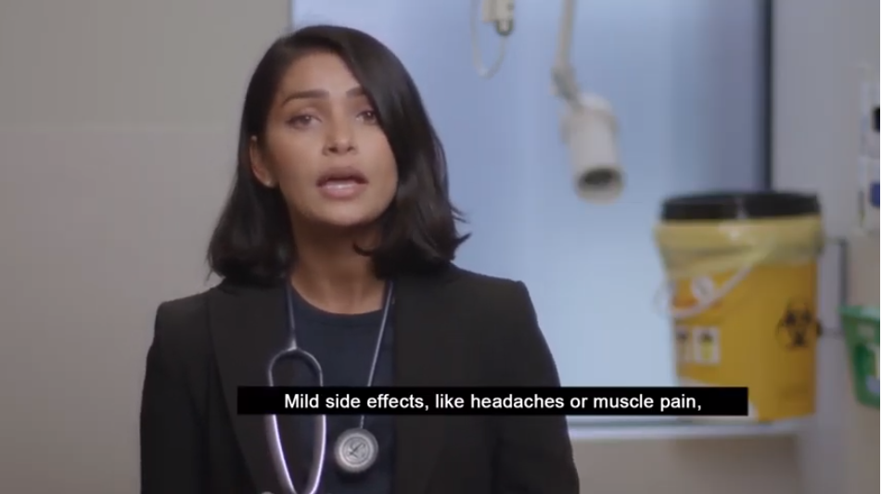
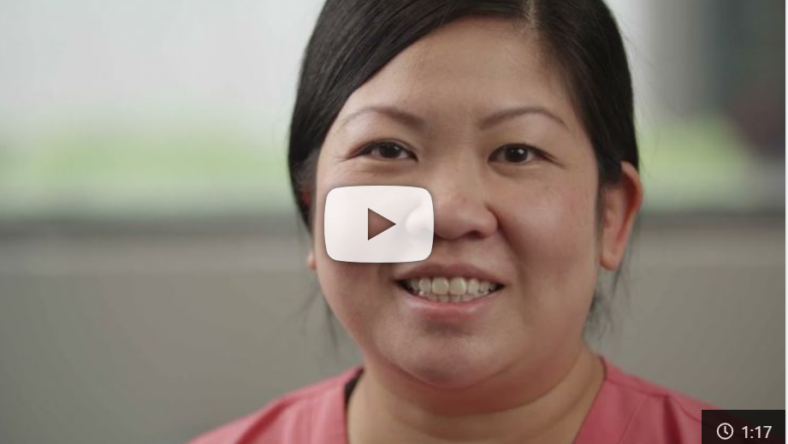
COVID-19 Vaccination Program: Australian Government vaccine overview videos
Available in: Arabic, Burmese, Simplified Chinese, Traditional Chinese, Dari, English, Hindi, Karen, Khmer, Laotian, Malay, Nepali, Persian, Punjabi, Spanish, Swahili, Tagalog, Urdu and Vietnamese.
Link: COVID-19 vaccine safety and approval process
Link: How COVID-19 vaccines work
Link: COVID-19 vaccines are available for everyone in Australia
Link: COVID-19 vaccines are available for everyone in Australia – audio content

Slide 14
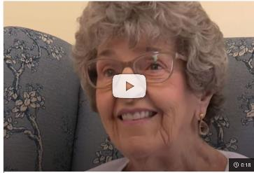
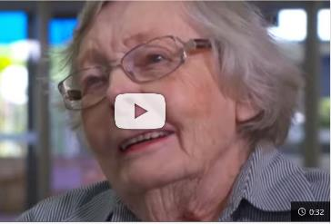
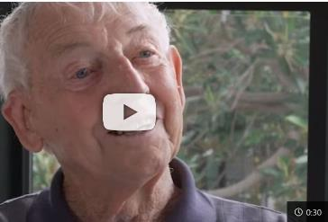
COVID-19 Vaccination Program: Australian Government aged care vaccine experiences
Available in:
Arabic, Simplified Chinese, Traditional Chinese, English, Greek, Hindi, Italian, Korean
Available in:
Arabic, Simplified Chinese, Traditional Chinese, English, Greek, Hindi, Italian, Korean, Vietnamese
Available in:
Arabic, Simplified Chinese, Traditional Chinese, English, Greek, Hindi, Italian, Korean, Vietnamese
Link: Patricia’s aged care vaccine experience
Link: Nancy’s aged care vaccine experience
Link: Cliff’s aged care vaccine experience

Slide 15
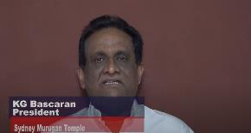
COVID-19 Vaccination Program: vaccination messages from NSW religious leaders
Filipino:
Father Eduardo Orilla
St Joachim’s Catholic Church
Tamil:
KG Bascaran, President
Sydney Murugan Temple
Sinhalese:
Bibile Gnanasantha Thero
Lankarama Buddhist Temple, Schofields
Link to video
Link to video
Link to video
Arabic:
Reverend Father Fadi Nemme
St Michael Antiochian Orthodox Church
Telugu:
Reverend Enoch Nagabyrava
St Marys Baptist Church
English:
Pastor Larry Galbraith
Epping Church of Christ
Link to video
Link to video
Link to video

Slide 16
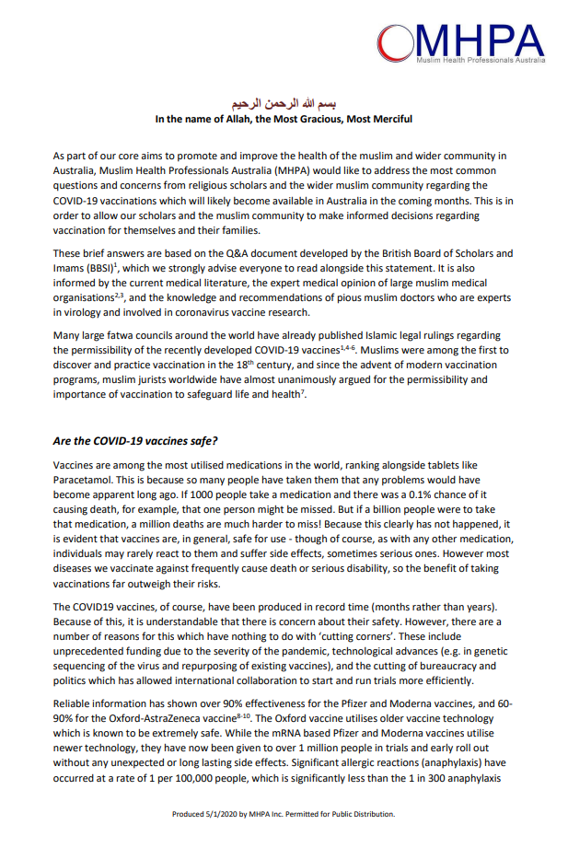
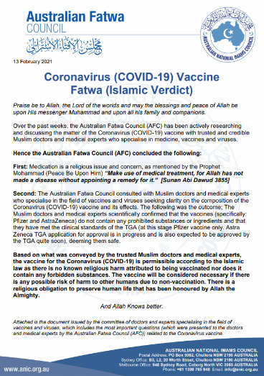
Statements of support from religious organisations on COVID-19 vaccinations
Link: Muslim Health Professionals Australia
Link: British Islamic Medical Association
Link: Australian Fatwa Council
Links:
Group Letter: Prioritising ethnic minorities in the COVID-19 Vaccination Program
Fasting & COVID vaccinations
BIMA Position Statement on Oxford AstraZeneca COVID-19 Vaccine
Summary of BIMA Position Statement on AstraZeneca COVID-19 Vaccine
Statement on Changes to Vaccination Schedule for Pfizer/BioNTech Vaccines
Summary of BIMA Position Statement on Pfizer COVID-19 Vaccine

Slide 17
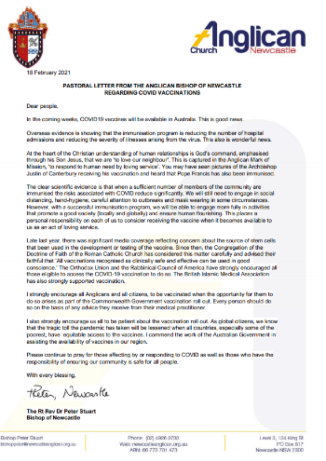
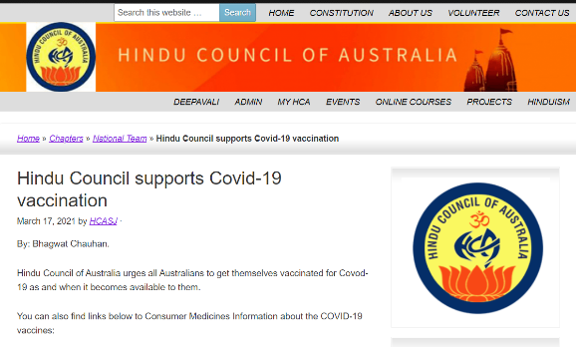
Statements of support from religious organisations on COVID-19 vaccinations
Link: Anglican Church - Newcastle
Link: Hindu Council of Australia

Slide 18
COVID-19 Vaccination Program: vaccination presentation (for sharing with community)
A presentation has been designed to provide community leaders and organisations information on the COVID-19 Vaccination Program and help them deliver this information to their audiences.
To assist, additional talking points, links to further information and relevant sources are provided in the notes section of the presentation where needed.
Link: COVID-19 vaccination presentation

Slide 19
Australian Government COVID-19 Stakeholder Pack: May 2021
The Australian Government COVID-19 Vaccines Multicultural Outreach stakeholder pack for May 2021 is now available.
This pack contains the latest information about COVID-19 vaccines available to everyone in Australia, including in-language communication resources.
Link: Australian Government COVID-19 Stakeholder Pack (May 2021)

Slide 20
COVID-19 Vaccination Program: Australian Government content libraries by language
The below links provide access to the Australian Government’s COVID-19 Vaccine Resource Hub. Here you can download additional videos, audio files, social content and posters.
Content can be downloaded by clicking on the arrow below each piece of content.
Links:
Arabic | Arabic – Sudanese | Assyrian | Burmese | Dari | English | Greek
Hazaragi | Hindi | Indonesian | Italian | Japanese | Karen | Khmer
Korean | Lao | Macedonian | Malay | Nepali | Persian – Farsi | Polish
Portuguese | Punjabi | Russian | Serbian | Simplified Chinese | Somali | Spanish
Swahili | Tagalog – Filipino | Tamil | Thai | Traditional Chinese | Turkish | Urdu
Vietnamese

Slide 21
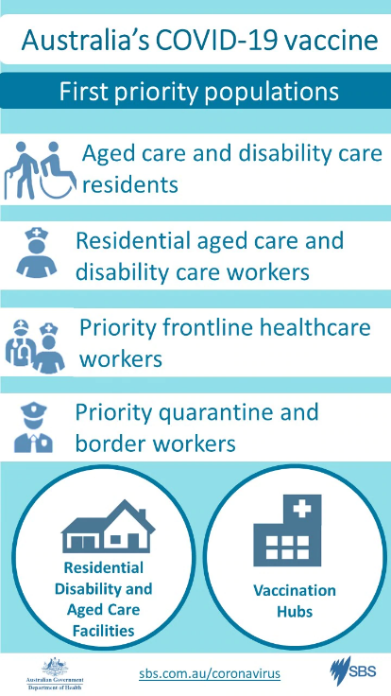
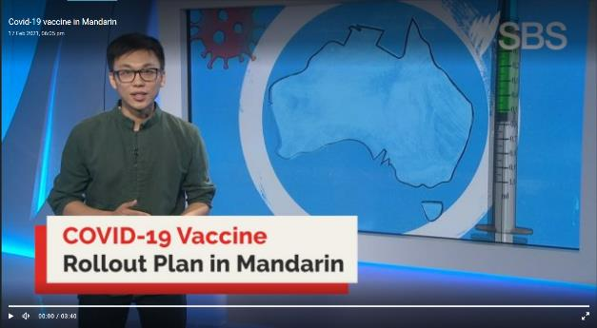
COVID-19 Vaccination Program: SBS Coronavirus Portal
In conjunction with the latest information on nsw.gov.au, SBS also has information about COVID-19 vaccines and COVID-19 updates available in more than 60 languages.
Link: sbs.com.au/language/coronavirus
Link: sbs.com.au/language/english/coronavirus-vaccine-rollout-in-australia-in-your-language

Slide 22
COVID safe behaviours content
Following pages include:
- Newsletter content
- Check-in resources
- Symptoms, testing and isolation resources
- Hand washing resources
- Wearing a mask and physical distancing resources
- COVID-19 information (in-language)

Slide 23
Community communication: newsletter/website content
Here’s how you can help NSW stay COVID safe
COVID-19 vaccinations have started in NSW. Although vaccination is an important part of helping protect against COVID-19, it’s just one piece of the puzzle. Continuing to maintain COVID safe behaviours is just as vital.
There are seven things you can do to help NSW stay COVID safe:
Get vaccinated when it is your turn
Check-in and out of venues wherever you can. You can do this through the Service NSW app or other electronic record-keeping systems
Get tested immediately if you have any COVID-19 symptoms, even if mild. Self-isolate until you get a negative test result
Wash your hands regularly
Choose to go outdoors, or use large well-ventilated indoor spaces, when meeting family and friends
Physically distance where you can. It is strongly recommended to wear a face mask in situations where it’s difficult to keep your distance, such as on public transport.
If we do this we can continue to do the things we love, be with our family and friends, and help keep our community open.
To download right click and select ‘Save as Picture’
Note: The following pages have links to translated content for COVID safe behaviours

Slide 24
COVID safe behaviours: check in and out venues
Links to download:
Arabic, Assyrian, Bangla, Simplified Chinese, Traditional Chinese, Dari, English, Farsi, Greek, Italian, Korean, Nepali, Spanish, Tamil, Thai, Vietnamese
Links to download:
Arabic, Assyrian, Bangla, Simplified Chinese, Traditional Chinese, Dari, English, Greek, Italian, Korean, Nepali, Persian, Spanish, Thai, Vietnamese

Slide 25
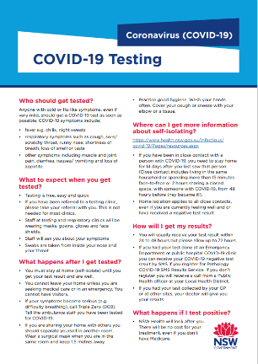
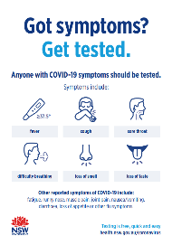
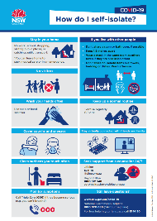
COVID safe behaviours: symptoms, testing and isolation
Links to download: Arabic, Bangla, Simplified Chinese, English, Greek, Gujrati, Hindi, Indonesian, Italian, Khmer, Korean, Lao, Nepali, Punjabi, Russian, Spanish, Thai, Vietnamese
Links to download: Arabic, Armenian, Assyrian, Bangla, Burmese, Simplified Chinese, Traditional Chinese, Croatian, Dari, Dinka, English, Farsi, Filipino, French, Greek, Gujrati, Hazaragi, Hindi, Indonesian, Italian, Japanese, Karen, Khmer, Kinyarwanda, Kirundi, Korean, Kurdish-Kurmanji, Kurdish-Sorani, Lao, Macedonian, Maltese, Mongolian, Nepali, Pashto, Polish, Portuguese, Punjabi, Russian, Serbian, Sinhalese, Spanish, Swahili, Tamil, Thai, Tibetan, Tigrinya, Tongan, Turkish, Urdu, Vietnamese
Links to download: Arabic, Assyrian, Bangla, Simplified Chinese, Traditional Chinese, English, Farsi, Greek, Hindi, Italian, Khmer, Korean, Lao, Nepali, Punjabi, Samoan, Spanish, Thai, Tongan, Vietnamese

Slide 26
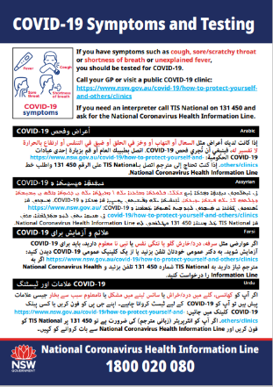
COVID safe behaviours: symptoms, testing and isolation
Links to download:
Arabic, Simplified Chinese, Traditional Chinese, English, Greek, Hindi, Vietnamese
Links to download:
NB: Resource is multilingual
Arabic, Assyrian, Farsi, Urdu
Armenian, Croatian, Russian, Serbian
Bangla, Nepali, Punjabi, Tamil
Burmese, Karen, Swahili, Tibetan
Simplified Chinese, Traditional Chinese, Korean, Vietnamese
Dari, Khmer, Kurdish-Kurmanji
Dinka, Kirundi, Samoan, Tongan
French, Portuguese, Spanish, Turkish
Greek, Italian, Macedonian, Polish
Indonesian, Japanese, Mongolian, Thai

Slide 27
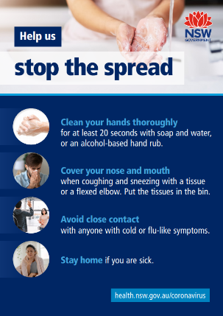
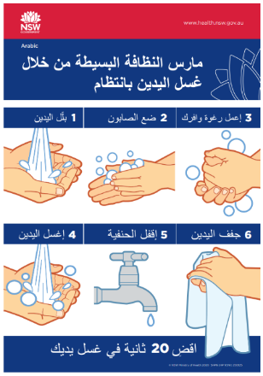
COVID safe behaviours: wash hands regularly
Links to download: Arabic, Simplified Chinese, Traditional Chinese, English, Greek, Hindi, Vietnamese
Links to download: Arabic, Bangla, Burmese, Simplified Chinese, Dari, English, Farsi, Greek, Indonesian, Italian, Japanese, Khmer, Korean, Mongolian, Nepali, Portuguese, Spanish, Swahili, Thai, Tibetan, Vietnamese
Links to download: Arabic, Bangla, Simplified Chinese, Greek, Italian, Korean, Nepali, Vietnamese

Slide 28
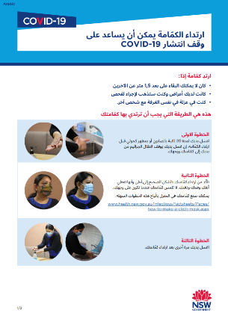
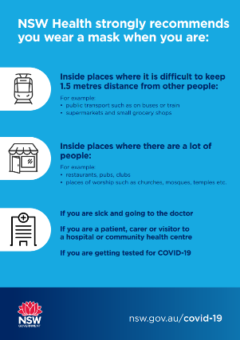
COVID safe behaviours: wear a mask when you can’t physically distance from others or where required
Links to download: Arabic, Armenian, Assyrian, Simplified Chinese, Traditional Chinese, Dari, Dinka, English, Filipino, French, Greek, Gujarati, Hazaragi, Hindi, Indonesian, Italian, Japanese, Khmer, Korean, Kurdish-Kurmanji, Lao, Maltese, Nepali, Pashto, Persian, Punjabi, Sinhalese, Spanish, Tamil, Thai, Tongan, Turkish, Urdu, Vietnamese
Links to download: Arabic, Assyrian, Armenian, Bangla, Burmese, Simplified Chinese, Traditional Chinese, Croatian, Dari, Dinka, English, Filipino, French, Greek, Gujarati, Hazaragi, Hindi, Indonesian, Italian, Japanese, Karen, Kinyarwanda, Kirundi, Kurdish-Kurmanji, Khmer, Korean, Kurdish, Lao, Macedonian, Maltese, Mongolian, Nepali, Pashto, Persian, Polish, Portuguese, Punjabi, Russian, Samoan, Serbian, Swahili, Sinhalese, Spanish, Tamil, Thai, Tibetan, Tigrinya, Tongan, Turkish, Urdu, Vietnamese

Slide 29
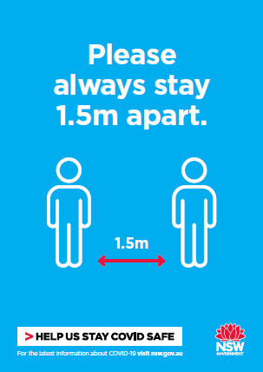
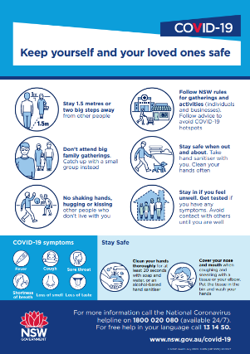
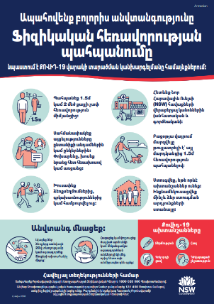
COVID safe behaviours: Keep physically distancing from others where you can
Links to download: Arabic, Simplified Chinese, Traditional Chinese, English, Greek, Hindi, Vietnamese
Links to download: Arabic, Bangla, Simplified Chinese, English, Greek, Italian, Korean, Nepali, Vietnamese
Links to download: Armenian, Assyrian, Burmese, Traditional Chinese, Croatian
Dari, Dinka, French, Indonesian, Japanese, Khmer, Kurdish-Kurmanji, Lao, Macedonian, Mongolian, Persian, Polish, Portuguese, Punjabi, Russian, Serbian, Spanish, Swahili, Tamil, Thai, Turkish, Urdu

Slide 30
COVID safe behaviours: Read COVID-19 information in language
Links to download: Arabic, Bangla, Farsi, Filipino, Greek, Hindi, Indonesian, Italian, Korean, Nepali, Simplified Chinese, Spanish, Tamil, Traditional Chinese, Urdu, Vietnamese
Links to download: Arabic, Bangla, Farsi, Filipino, Greek, Hindi, Indonesian, Italian, Korean, Nepali, Simplified Chinese, Spanish, Tamil, Traditional Chinese, Urdu, Vietnamese

